Slide 1

IWIC Application
Mobile and Web Engineering

Slide 2

What we showed you last time ?

Slide 3
Wireframes
User interface
Project life cycle
Notes:
Show examples of the wireframes created previously, talk about each of them and their uses.
Also talk about the general life cycle of the project, for example create an example, get feedback make improvements so on so forth.

Slide 4
Firebase
Authentication
Functionality
Notifications
Notes:
Like Alex was saying – I will quickly run over the things I mentioned in the last presentation Firebase has a range of functions we can play with and adjust to our needs and requirements. The Authentication system in Firebase enables us to have a secure log in system backed up by Google. The functionality this provides is great for us as developers and great for the end user as well – it enables the end user to have their application up-to-date with the latest information by pulling the latest information down when the user opens the app providing there are connected to the internet. - Continuing on with the internet – if a user is connected to the internet the application can send notifications to a users device telling them about urgent information and events.

Slide 5
Payment methods
Different types
Tracking subscriptions , e.g software
Notes:
Last time we showed you a presentation about the research which was taken for Payment Methods and different types. We gave few examples of digital wallets (Google pay, Apple pay and Samsung pay) and we talked about the differences between them . We gave the reasons why these exact methods will be a easier way for users to pay and become members.
We also mentioned that we will talk more detailed about one of the main problems IWIC has at the moment – not being able to track the memberships (who paid and who didn't). Because this is a more fragile subject, we decided to talk specifically about it on out next meeting with you.

Slide 6


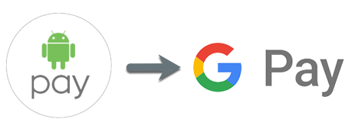

Slide 7
Progression so far

Slide 8
User interface
Actual application , with working login
Login, home screen
Example events
Notes:
Talk about the user interface we have created so far, show them the actual application and the features we are including, let james talk about firebase and how it fits with the application. Show them the other screens of the application and also cover the process in which desired changes will be made.

Slide 9

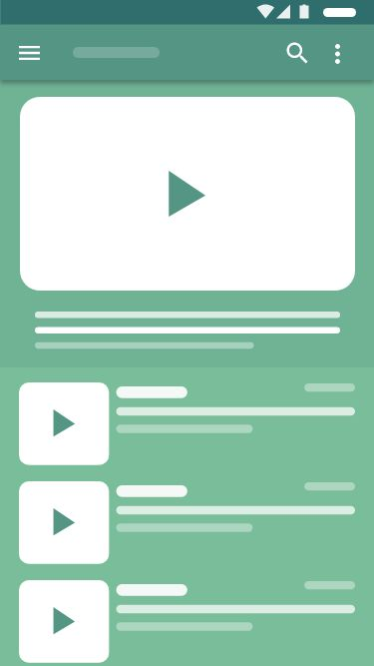
Updated progress
events
home
login
create account
about us
contact us
notifications
maps
potential payment screen
notice board
User interface creation
Defining required interfaces
Notes:
Talk about creation of the working user interface I have created. Talk about how working examples can be useful when it comes to understanding what you want from the application.
Also include about landscape modes aswell for example do you even want landscape mode on the application.

Slide 10
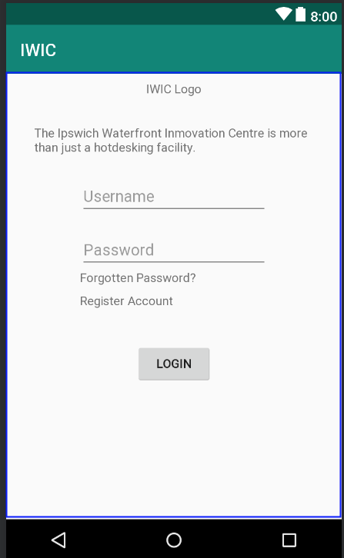
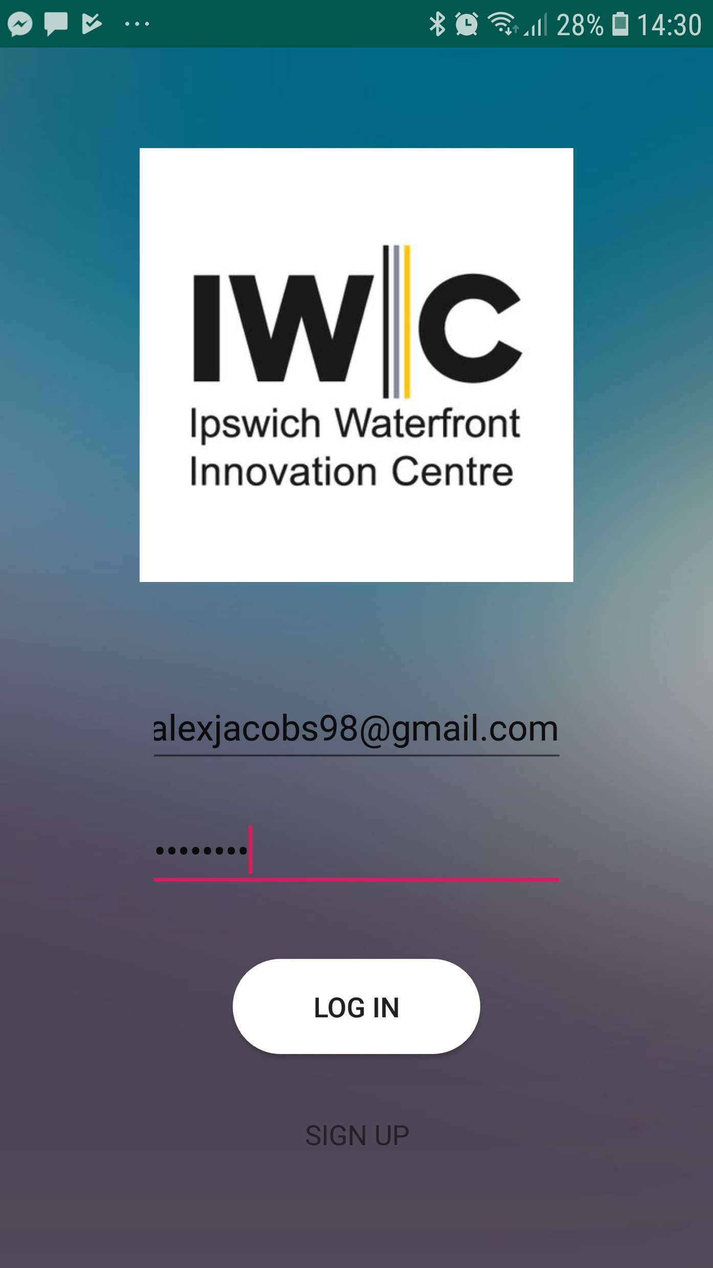
Updated progress
Notes:
Talk about creation of the working user interface I have created. Talk about how working examples can be useful when it comes to understanding what you want from the application.
Also include about landscape modes aswell for example do you even want landscape mode on the application.

Slide 11
Updated progress
More Firebase Implementation
login & register

Slide 12
Updated progress
the payment method we recommend is stripe
Event bright plans using new api knowledge
Notes:
We have came to the conclusion that Stripe has been the best prefferable payment method , but until Iwic doesn’t have a converstation with Finance, we won't be able to implement this in our application. Now we will talk a bit about Event bright and its functions. Alex will take over from here .

Slide 13
What should you expect from us ?

Slide 14
Working examples of the application
Guest Accounts

Slide 15
Talk about IWIC talking with finance
New meeting to get feedback
Notes:
Talk about the finance, that everything depends on them ( we can't do anything if it's not agreed on) . Setting a new date for a meeting and talking what we can talk on it >>> their choice about things.

Slide 16
Process of creation
Notes:
Talk about how soon the process of development will start, and when they can expect working examples. E.g we currently have a working login screen.
Also talk about now the actual development process has started what they can expect from us each week as the project progresses.

Slide 17
Any questions?
Thank you for your time.

